Slide 1
Service Oriented Architecture
Prepared by: Dr. Lubin Balasubramanian

Slide 2
Syllabus
Introduction: SOA and MSA Basics: Service Orientation in Daily Life, Evolution of SOA and MSA. Service oriented Architecture and Microservices architecture – Drivers for SOA, Dimensions of SOA, Conceptual Model of SOA, Standards and Guidelines for SOA, Emergence of MSA Enterprise-Wide SOA: Considerations for Enterprise-wide SOA, Strawman Architecture for Enterprise-wide SOA, Enterprise SOA Reference Architecture, Object-oriented Analysis and Design (OOAD) Process, Service-oriented Analysis and Design (SOAD) Process, SOA Methodology for Enterprise

Slide 3
Introduction to SOA and MSA Basics
SOA (Service-Oriented Architecture) and MSA (Microservices Architecture) are architectural styles based on services
SOA (Service-Oriented Architecture) and MSA (Microservices Architecture) are both frameworks that break large software systems into independent services, but they differ in scale, scope, and implementation.
Focus: Agility, Reuse, Interoperability

Slide 4
Introduction to SOA and MSA Basics
Monolithic is similar to a big container wherein all the software components of an application are assembled together and tightly packaged.
A Service-Oriented Architecture is essentially a collection of services. These services communicate with each other. The communication can involve either simple data passing or it could involve two or more services coordinating some activity. Some means of connecting services to each other is needed.
Microservices, Microservice Architecture, is an architectural style that structures an application as a collection of small autonomous services, modeled around a business domain.

Slide 5
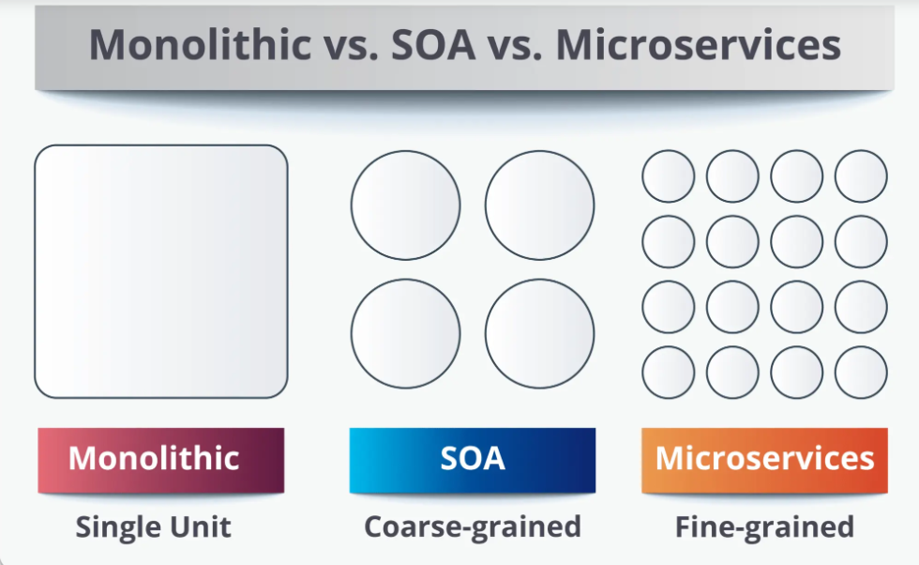
Introduction to SOA and MSA Basics

Slide 6
Services
A service is a self-contained unit of functionality that performs a specific business task and can be used by different applications over a network.
Example
Imagine an Online Shopping Website.
Different services exist independently:
Login Service
Payment Service
Order Service
Delivery Service
Email Notification Service
Each service performs only one job and communicates with other services using messages.

Slide 7
Services
Autonomous: A service works independently.Example:Payment Service can work even if Delivery Service is updated.
Loosely Coupled :Services do not depend heavily on each other.They only know what request to send and what response to expect.This makes maintenance easy.
Stateless: A service does not remember previous requests.Example:Customer checks balance.Later checks again.The service treats both requests independently.
Accessed through an Interface Applications cannot directly access the internal code.Instead, they use an interface (API).

Slide 8
Service Provider and Service Provider
Service Provider
The application that offers the service.
Example
Bank Payment Service
It provides
Pay Money
Check Balance
Refund
Service Consumer
The application that uses the service.
Example
Amazon uses the Bank's Payment Service.
Amazon is the consumer.
Bank is the provider.

Slide 9
Service Contract and Data Contract
Service Contract
A Service Contract defines
What operations are available
Input format
Output format
Rules for communication
A Data Contract defines what data is exchanged.
Example
Customer Data

Slide 10
Function VS Service
Function | Service
Exists inside the same program | Exists independently
Called locally | Called over a network
Tight coupling | Loose coupling
Language dependent | Language independent
Cannot usually be reused by other applications directly | Can be reused by many applications
Uses function call | Uses messages/API

Slide 11
Service-Oriented Architecture (SOA)
Service-Oriented Architecture (SOA) is an architectural style in which software applications are built by combining reusable, loosely coupled services that communicate over a network.
Goal: Enable reuse of services, Integrate different enterprise applications, Improve interoperability between systems.
Example: Consider a university management system.
Different departments have their own applications: Admissions, Library, Examination, Hostel, Finance.
Each department exposes its functionality as a service.
Service: All these services communicate through a common integration layer called the Enterprise Service Bus (ESB).

Slide 12
What is Microservices Architecture?
Definition: Microservices Architecture is an architectural style where an application is divided into many small, independent services, each responsible for a single business capability.
Each servicehas its own database, can be developed independently, can be deployed independently.
Example: Think about Amazon.
Instead of one huge application, Amazon has separate microservices:Login Service,Product Service,Cart Service, Payment Service, Order Service, Notification Service, Delivery Service.
Each service works independently.

Slide 13
What is Microservices Architecture?
Key Difference
SOA:One organization has many large business services. Example:BankCustomer Service, Loan Service, Insurance Service, Account Service
Services are generally larger.
Microservices:Each large service is further divided into many smaller services.
Example:Loan Service↓Loan ApplicationLoan ApprovalLoan EMILoan InterestLoan Status.
Each performs only one function.

Slide 14
Difference between SOA and Microservices
Feature | SOA | Microservices
Purpose | Integrate enterprise applications | Build scalable applications
Service Size | Large business services | Small services
Coupling | Loose | Very loose
Communication | ESB, SOAP, REST | Mostly REST, gRPC, messaging
Deployment | Often together | Independently deployable
Database | Often shared | Separate database per service
Scalability | Moderate | Very high
Technology | Usually same enterprise standards | Technology-independent
Fault Isolation | Lower | Higher
Development Team | Large centralized team | Small independent teams

Slide 15
Drivers for SOA
As businesses became larger and more competitive, companies needed software that was:
Flexible
Reusable
Faster
Less expensive
Easier to integrate
These needs became the drivers for SOA.
The drivers are classified into two categories:
Business Drivers
Technology Drivers

Slide 16
Driver 1: Rapid Business Process Changes
Meaning
Business requirements change frequently.
Companies should be able to update their software quickly.
Example
Suppose Amazon introduces
Same-day delivery
EMI payment
Cash on Delivery
Without SOA:
Entire application must be modified.
With SOA:
Only the Delivery Service or Payment Service is updated.
Benefit
✔ Faster adaptation to market changes.

Slide 17
Driver 2: Reduction of Process Cycle Time
Cycle time means the total time required to complete a business process.
The goal is to reduce the time taken.
Driver 3: Promotion of Business Through Multiple Channels
Customers access the same business using different channels.
Examples:Website ,Mobile App ,ATM ,Smart TV ,Voice Assistant
Instead of writing separate software for each platform, all use the same backend services.
Driver 4: Protection of Investments in Legacy Applications
Companies already invested millions in older software.
Instead of replacing it completely, SOA allows reuse.
Example
A bank has a 20-year-old account management system.
Rather than rewriting it,
they expose it as an Account Service.

Slide 18
Technology Drivers
Driver 1: Application Modernization
Old software should work with modern technologies.
Driver 2: Technology Change Management
Technology changes rapidly.
SOA allows organizations to change technologies without affecting users.
Driver 3: Integration and Interoperability
Different applications should communicate even if they use different technologies.

Slide 19
